Slide 1
Software Engineering CSC291 [Requirement Engineering]

Slide 2
Today’s Overview

Slide 3
Requirement Engineering
The requirements for a system are the descriptions of what the system should do?
The process of establishing the services that the customer requires from a system and the constraints under which it operates and is developed.
The process of finding out, analyzing, documenting and checking these services and constraints is called requirements engineering (RE).

Slide 4
Requirement Abstraction
“If a company wishes to let a contract for a large software development project, it must define its needs in a sufficiently abstract way that a solution is not pre-defined. The requirements must be written so that several contractors can bid for the contract, offering, perhaps, different ways of meeting the client organization’s needs. Once a contract has been awarded, the contractor must write a system definition for the client in more detail so that the client understands and can validate what the software will do. Both of these documents may be called the requirements document for the system.”

Slide 5
Broader types of Requirements
User Requirement
High-level abstract requirements
User requirements are statements, in a natural language plus diagrams, of what services the system is expected to provide to system users and the constraints under which it must operate.
System requirements
System requirements are more detailed descriptions of the software system’s functions, services, and operational constraints.
The system requirements document should define exactly what is to be implemented. It may be part of the contract between the system buyer and the software developers.
Business requirements
High-level requirement.
A business requirements document (BRD) outlines measurable project goals for the business, users and other stakeholders. Business analysts, leaders and other project sponsors create the BRD at the start of the project. This document defines the why behind the build.

Slide 6
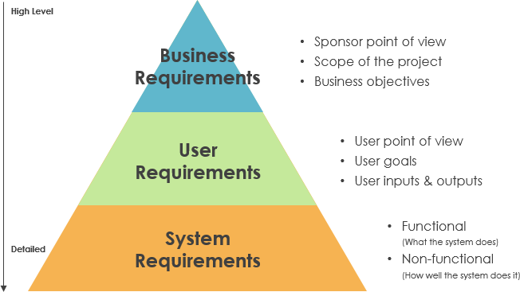

Slide 7
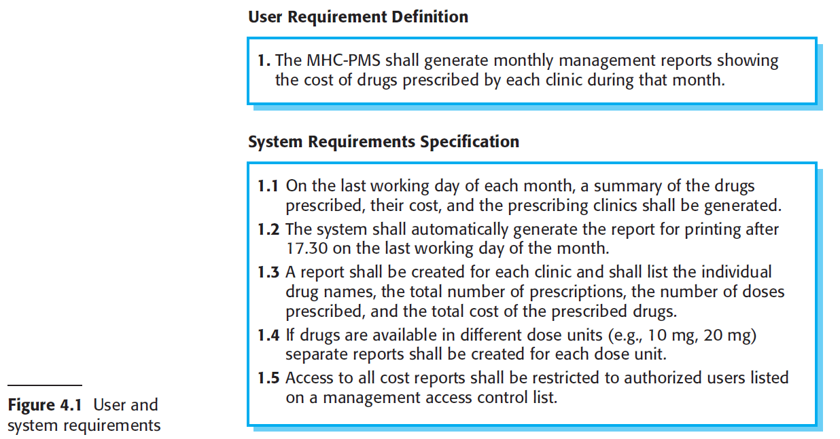

Slide 8
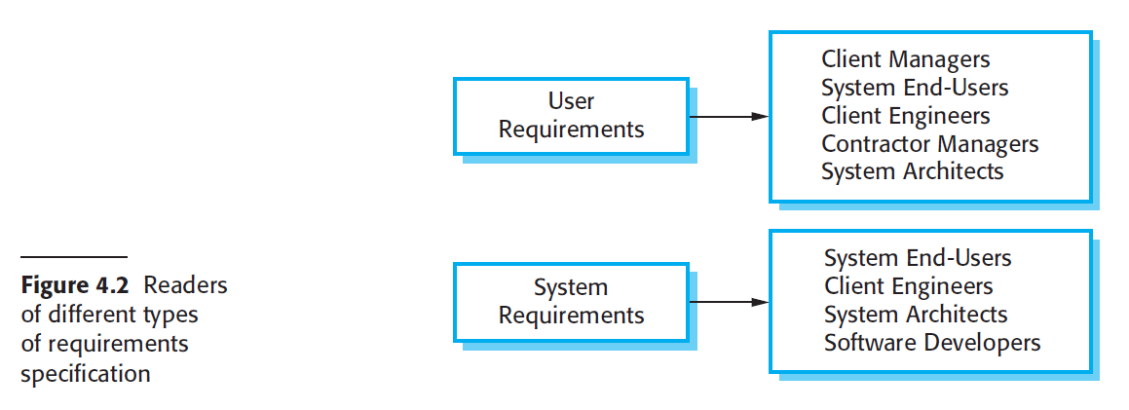

Slide 9
Business requirements
Describe why the organization is implementing the system—the business benefits the organization hopes to achieve.
The focus is on the business objectives of the organization or the customer who requests the system.
Example
Suppose an airline wants to reduce airport counter staff costs by 25 percent. This goal might lead to the idea of building a kiosk that passengers can use to check in for their flights at the airport.
Business requirements typically come from the funding sponsor for a project, the acquiring customer, the manager of the actual users, the marketing department, or a product visionary.
Business requirements used to record in a vision and scope document.

Slide 10
User requirements
User requirements describe goals or tasks the users must be able to perform with the product that will provide value to someone.
Ways to represent user requirements include use cases (Kulak and Guiney 2004),
user stories (Cohn 2004), and event-response tables.
Ideally, actual user representatives will provide this information.
User requirements describe what the user will be able to do with the system.
Example
An example of a use case is “Check in for a flight” using an airline’s website or a kiosk at the airport.
Written as a user story, the same user requirement might read:
“As a passenger, I want to check in for a flight so I can board my airplane.” It’s important to remember that most projects have multiple user classes, as well as other stakeholders whose needs also must be elicited.

Slide 11
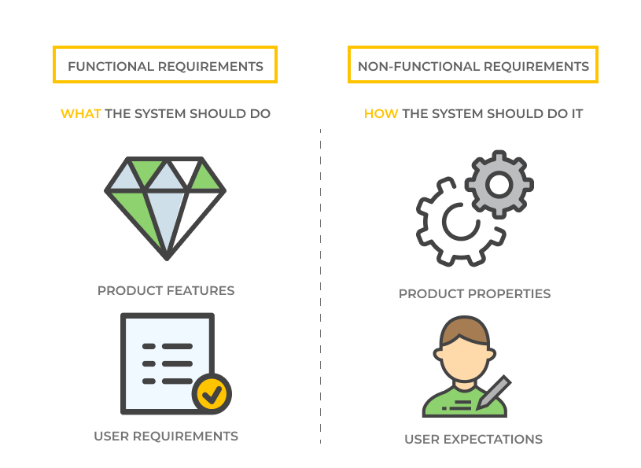
System Requirements
Software system requirements are often classified into:

Slide 12
Functional Requirements
Functional requirements specify the behaviors the product will exhibit under specific conditions.
They describe what the developers must implement to enable users to accomplish their tasks (user requirements), thereby satisfying the business requirements.
This alignment among the three levels of requirements is essential for project success.
Example
Functional requirements often are written in the form of the traditional “shall” statements:
“The Passenger shall be able to print boarding passes for all flight segments for which he has checked in”
or
“If the Passenger’s profile does not indicate a seating preference, the reservation system shall assign a seat.”

Slide 13
Functional Requirements for MHC-PMS
A user shall be able to search the appointments lists for all clinics.
The system shall generate each day, for each clinic, a list of patients who are expected to attend appointments that day.
Each staff member using the system shall be uniquely identified by his or her 8-digit employee number.

Slide 14
FR characteristics
Requirements Imprecision
Problems arise when requirements are not precisely stated.
Ambiguous requirements may be interpreted in different ways by developers and users.
Consider the term ‘search’ in requirement 1:
User intention – search for a patient name across all appointments in all clinics;
Developer interpretation – search for a patient name in an individual clinic. User chooses clinic then search. OR – search for all patients appointments in all clinics
Requirements Completeness and Consistency
In principle, requirements should be both complete and consistent.
They should include descriptions of all facilities required.
There should be no conflicts or contradictions in the descriptions of the system facilities.

Slide 15
Non-Functional Requirements
These define system properties and constraints
e.g. reliability, response time and storage requirements.
e.g. I/O device capability, data representations, etc.
such as performance, security, or availability
More critical than functional requirements. If these are not met, the system may be useless.
For example, if an aircraft system does not meet its reliability requirements, it will not be certified as safe for operation.

Slide 16
NFR Criticality
Non-functional requirements may affect the overall architecture of a system rather than the individual components.
A single non-functional requirement, such as a security requirement, may generate a number of related functional requirements that define system services that are required.
It may also generate requirements that restrict existing requirements.

Slide 17
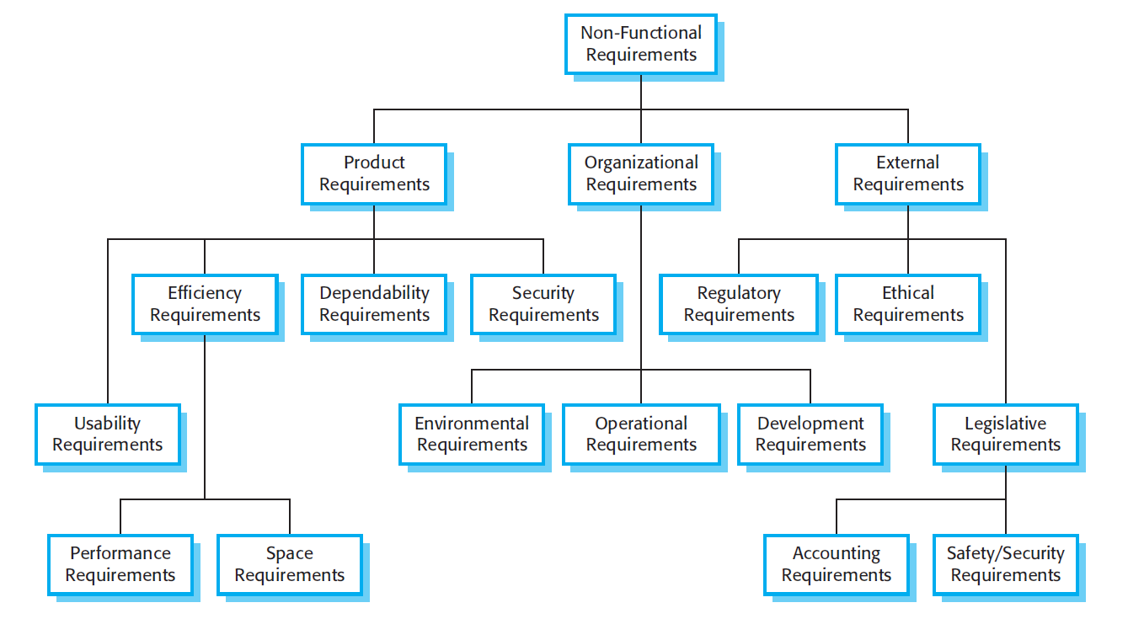
NFR Classification

Slide 18
Non-Functional Classification
Product requirements
Requirements which specify that the delivered product must behave in a particular way e.g. execution speed, reliability, etc.
Organisational requirements
Requirements which are a consequence of organisational policies and procedures e.g. process standards used, implementation requirements, etc.
External requirements
Requirements which arise from factors which are external to the system and its development process e.g. interoperability requirements, legislative requirements, etc.

Slide 19
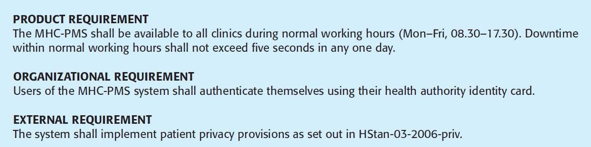
Non-functional Requirements in MHC-PMS

Slide 20
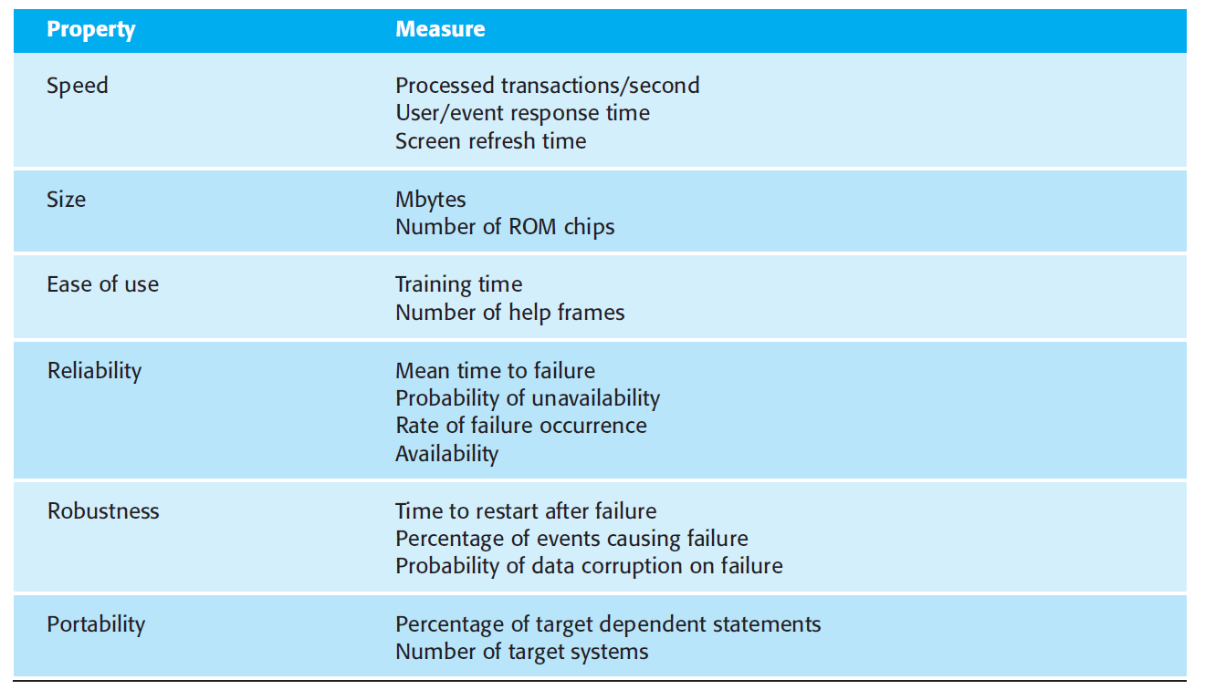
Metrics to specify NF requirements

Slide 21
Requirement Elicitation
Elicitation encompasses all of the activities involved with discovering requirements, such as interviews, workshops, document analysis, prototyping, and others.
The key actions are:
Identifying the product’s expected user classes and other stakeholders.
Understanding user tasks and goals and the business objectives with which those tasks align.
Learning about the environment in which the new product will be used.
Working with individuals who represent each user class to understand their functionality needs and their quality expectations.
Perform feasibility analysis

Slide 22
Requirement Specification

Slide 23
Software Requirement Specification (SRS)
A software requirements specification (SRS) is a complete description of the behavior of the system to be developed
A document that clearly and precisely describes, each of the essential requirements of the software and the external interfaces. (functions, performance, design constraint, and quality attributes)
the official statement of what is required of the system developers.
Should include both a definition of user requirements and a specification of the system requirements.
It is NOT a design document. As far as possible, it should set of WHAT the system should do rather than HOW it should do it.
Each requirement is defined in such a way that its achievement is capable of being objectively verified by a prescribed method; for example inspection, demonstration, analysis, or test.

Slide 24
Requirements Document Variability
Information in requirements document depends on type of system and the approach to development used.
Systems developed incrementally will, typically, have less detail in the requirements document.
Requirements documents standards have been designed e.g. IEEE standard. These are mostly applicable to the requirements for large systems engineering projects.
Template of SRS followed by CUI.

Slide 25
1. Natural language specification
Requirements are written as natural language sentences supplemented by diagrams and tables.
Used for writing requirements because it is expressive, intuitive and universal. This means that the requirements can be understood by users and customers.

Slide 26
Guidelines for writing requirements
Invent a standard format and use it for all requirements.
Use language in a consistent way. Use should for desirable requirements.
Use text highlighting to identify key parts of the requirement.
Avoid the use of computer jargon.
Include an explanation (rationale) of why a requirement is necessary.

Slide 27
Problems with natural language
Lack of clarity
Precision is difficult without making the document difficult to read.
Requirements confusion
Functional and non-functional requirements tend to be mixed- up.
Requirements mixture
Several different requirements may be expressed together.

Slide 28
Example requirements for the insulin pump software system
3.2 The system will measure the blood sugar and deliver insulin, if required, every 10 minutes. (Changes in blood sugar are relatively slow so more frequent measurement is unnecessary; less frequent measurement could lead to unnecessarily high sugar levels.)
3.6 The system will run a self-test routine every minute with the conditions to be tested and the associated actions defined in Table 1. (A self-test routine can discover hardware and software problems and alert the user to the fact the normal operation may be impossible.)

Slide 29
2. Form-based specifications
Definition of the function or entity.
Description of inputs and where they come from.
Description of outputs and where they go to.
Information about the information needed for the computation and other entities used.
Description of the action to be taken.
Pre and post conditions (if appropriate).
The side effects (if any) of the function.

Slide 30
NFR- Goals and Requirements
A common problem with non-functional requirements is that users or customers often propose these requirements as general goals
Non-functional requirements may be very difficult to state precisely and imprecise requirements may be difficult to verify.
Goal
A general intention of the user such as ease of use.
Verifiable non-functional requirement
A statement using some measure that can be objectively tested.
Goals are helpful to developers as they convey the intentions of the system users.

Slide 31
Goal to NFR
How a manager might express usability requirements as GOAL
The system should be easy to use by medical staff and should be organized in such a way that user errors are minimized. (Goal)
How the goal could be expressed as a ‘testable’ nonfunctional requirement
Medical staff will be able to use all the system functions after four hours of training.
After this training, the average number of errors made by experienced users will not exceed two per hour of system use. (Testable non- functional requirement)

Slide 32
Requirements Characteristic
Good requirements should have the following characteristics:
Unambiguous
Testable (verifiable)
Clear (concise, terse, simple, precise)
Correct
Understandable
Feasible (realistic, possible)
Independent
Atomic
Necessary
Implementation-free (abstract)

Slide 33
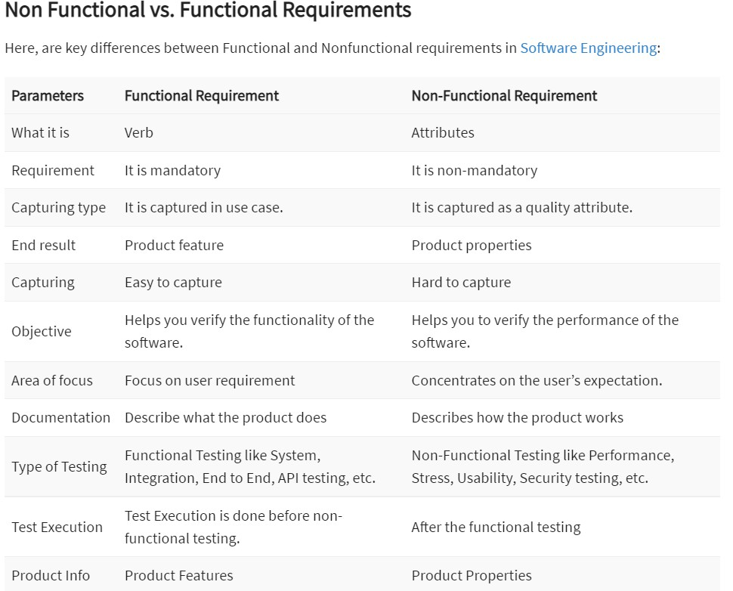
Functional VS Non-Functional Req

Slide 34
Good and Bad Requirement
R1: Only authorized persons are allowed to enter the building.
R2: The doorbell button will be blue, round, and with a diameter of 20 mm.
R1 is a goal,
R2 is a detailed specification
R2 is in fact three different requirements
R4: The system will play the sound ’alarm’ when the door is opened.
R4: The system will play the sound ’C:\alarm.wav’ once, at the highest volume setting in the main speaker for the building when the door opens.

Slide 35
Good and Bad Requirement
R5: The system will respond quickly to user interaction.
R5: The system will respond to user interaction within maximum 2 seconds, minimum 0.2 seconds, average 1 second.
R11: When a user enters a correct code, the door will open.
R11: When a user enters the code associated with him/her on keypad K2 the door D2 will unlock and remain unlocked for 30 seconds.

Slide 36
Requirements Gathering Techniques

Slide 37
Requirements Discovery - Elicitation
The process of gathering information about the required and existing systems and distilling the user and system requirements from this information.
Interaction is with system stakeholders from managers to external regulators.
Sources of information may include documentation, system stakeholders, and specifications of similar systems
Systems normally have a range of stakeholders.

Slide 38
Stakeholders in the MHC-PMS
Patients whose information is recorded in the system.
Doctors who are responsible for assessing and treating patients.
Nurses who coordinate the consultations with doctors and administer some treatments.
Medical receptionists who manage patients’ appointments.
IT staff who are responsible for installing and maintaining the system.

Slide 39
Techniques of Eliciting Requirements
Analysts can employ several techniques to elicit the requirements from the customer.
Survey/Questionnaire
Focus groups (requirements workshops) and creating requirements lists.
Naturalistic observation
Document Analysis
Interviews
Ethnography
Prototyping
Brainstorming
Scenarios
Use cases

Slide 40
Techniques Contd.
Questionnaires: Series of questions designed to elicit specific information from user. The questions may require different kinds of answers: some require a simple Yes/No, others ask us to choose from a set of pre-supplied answers.
SurveyMonkey
Popular solution to let you design and distribute questionnaires
Focus groups and workshops: Interviews tend to be one on one, and elicit only one person’s perspective. It can be very revealing to get a group of stakeholders together to discuss issues and requirements.
Document Analysis: Procedures and rules are often written down in a manual and these are a good source of data about the steps involved in an activity and any regulations governing a task.

Slide 41
Techniques Contd.
Interviews: Interviews are good for getting an overall understanding of what stakeholders do, how they might interact with the new system, and the difficulties that they face with current system.
Types of interview
Closed interviews based on pre-determined list of questions
Open interviews where various issues are explored with stakeholders.
Normally a mix of closed and open-ended interviewing.

Slide 42
Techniques Contd.
Ethnography: An observational technique that can be used to understand operational processes and help derive requirements for these processes. It helps discover the implicit system requirements that reflect the actual way that people work rather than formal processes defined by the organization.
A social scientists spends a considerable time observing and analyzing how people actually work.
People do not have to explain or articulate their work.
Social and organizational factors of importance may be observed.
Ethnographic studies have shown that work is usually richer and more complex than suggested by simple system models.

Slide 43
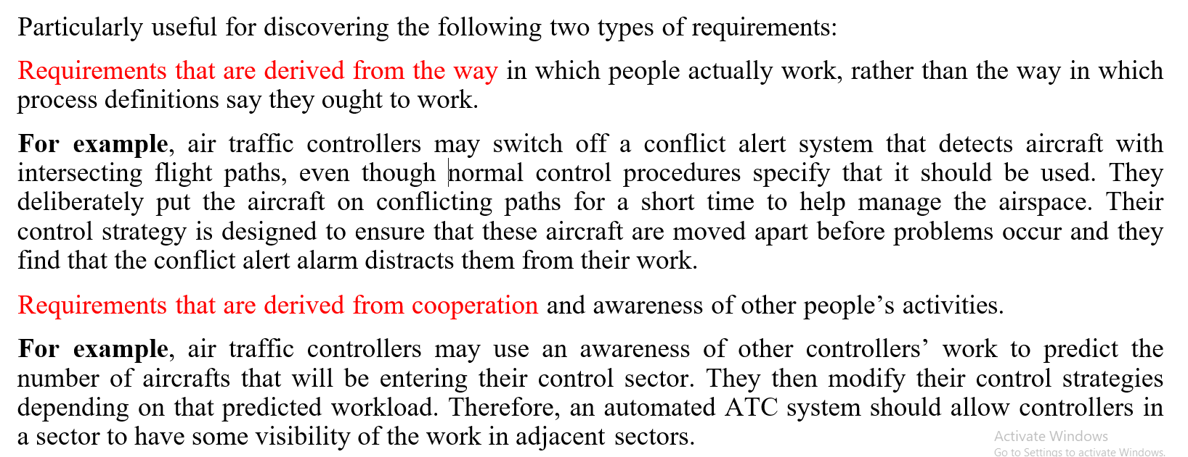
Scope of ethnography

Slide 44
Techniques Contd.
Prototyping:
Repetitive process
Elementary version of system is built
Replaces or augments SDLC
Goal: to develop concrete specifications for ultimate system
Quickly converts requirements to working version of system
Once the user sees requirements converted to system, will ask for modifications or will generate additional requests
Brainstorming: is a situation where a group of people meet to generate new ideas and solutions around a specific domain of interest by removing inhibitions. People are able to think more freely, and they suggest as many spontaneous new ideas as possible. All the ideas are noted down without criticism and after the brainstorming session the ideas are evaluated
Individual Brainstorming
Group Brainstorming

Slide 45
Techniques Contd.
Scenarios And Use Cases
Scenarios
An informal narrative story of users
Natural way to explain
Scenarios can be particularly useful for adding detail to an outline requirements description.
Use cases
Show interaction with a system
Show detailed understanding of the interaction

Slide 46
Scenarios
Scenarios are real-life examples of how a system can be used.
They should include
A description of the starting situation;
A description of the normal flow of events;
A description of what can go wrong;
Information about other concurrent activities;
A description of the state when the scenario finishes.

Slide 47
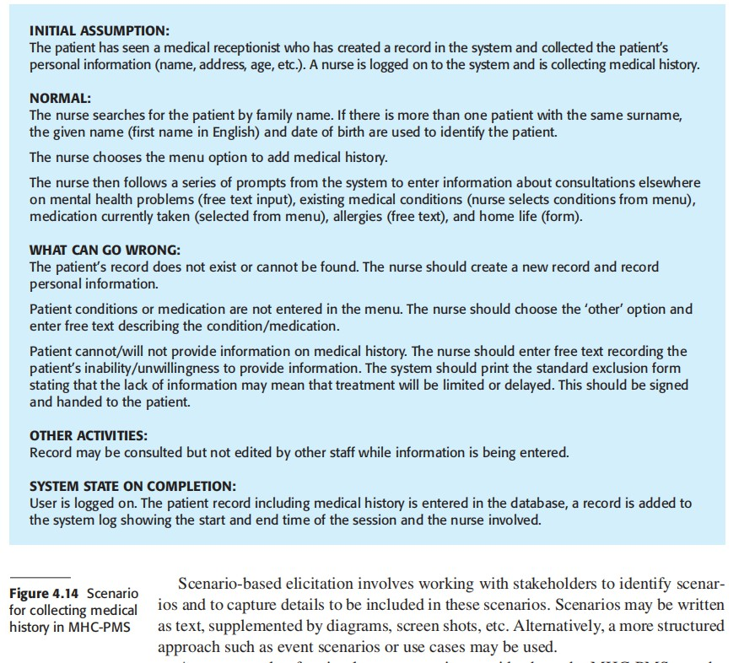
Scenario for collecting medical history in MHC-PMS

Slide 48
Use Cases
A use case identifies the actors involved in an interaction and names the type of interaction. Use cases are documented using a high-level use case diagram.
Use-cases are a scenario based technique in the UML which identify the actors in an interaction and which describe the interaction itself.
A set of use cases should describe all possible interactions with the system.
Sequence diagrams may be used to add detail to use-cases by showing the sequence of event processing in the system.

Slide 49
Use Cases Contd.
Use Cases:
Hold Functional Requirements in an easy to read, easy to track text format.
Represents the goal of an interaction between an actor and the system. The goal represents
a meaningful and measurable objective for the actor.
Records a set of paths (scenarios) that traverse an actor from a trigger event (start of the use case) to the goal (success scenarios).
Records a set of scenarios that traverse an actor from a trigger event toward a goal but fall
short of the goal (failure scenarios).
Are multi-level: one use case can use/extent the functionality of another.
Use Cases Do Not…
Specify user interface design. They specify the intent, not the action Detail
Specify implementation detail (unless it is of particular importance to the actor to be assured that the goal is properly met)

Slide 50
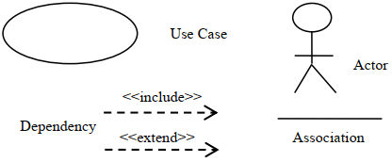
Elements of Use-Case Diagrams
The elements of a use-case diagram include
actors, use cases, subject boundaries, and a set of relationships among actors, actors and use cases, and use cases.
These relationships consist of
association, include, extend, and generalization relationships.

Slide 51

Actors
An actor: Is a person or system that derives benefit from and is external to the subject.
Is depicted as either a stick figure (default) or, if a nonhuman actor is involved, a rectangle with <<actor>> in it (alternative).
Is labeled with its role.
Can be associated with other actors using a specialization/superclass association, denoted by an arrow with a hollow arrowhead.
Is placed outside the subject boundary.

Slide 52

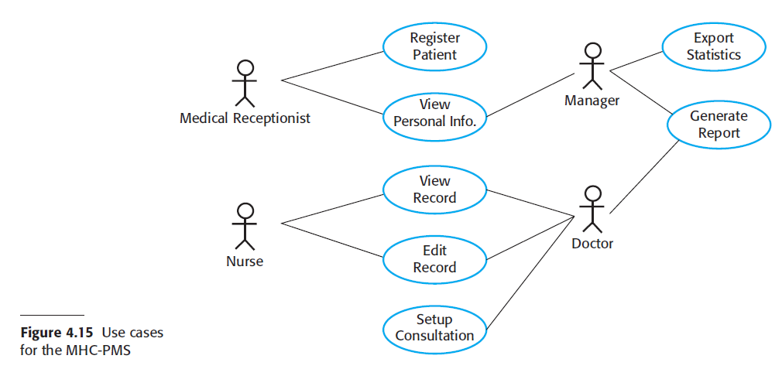
Use Case
Represents a major piece of system functionality.
Can extend another use case.
Can include another use case.
Is placed inside the system boundary.
Is labeled with a descriptive verb–noun phrase.

Slide 53
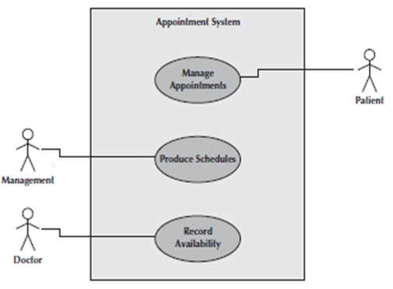
A Subject Boundary
Includes the name of the subject inside or on top.
Represents the scope of the subject, e.g., a System or an individual business process.

Slide 54

Use case Diagram Relationships
An association relationship:
Links an actor with the use case(s) with which it interacts.
An include relationship:
Represents the inclusion of the functionality of one use case within another.
Has an arrow drawn from the base use case to the used use case.

Slide 55


Use case Diagram Relationships
An extend relationship:
Represents the extension of the use case to include optional behavior.
Has an arrow drawn from the extension use case to the base use case.
A generalization relationship:
Represents a specialized use case to a more generalized one.
Has an arrow drawn from the specialized use case to the base use case.

Slide 56
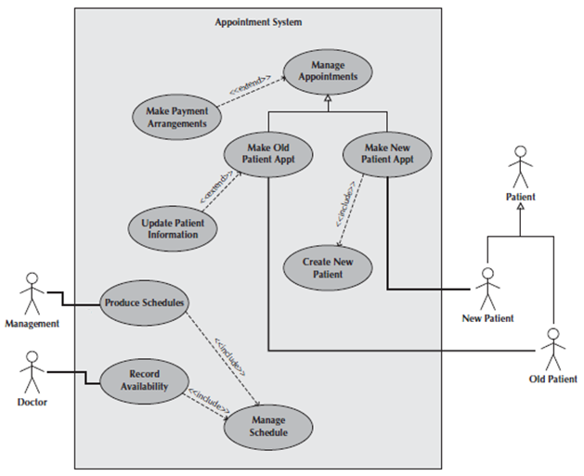
Example

Slide 57
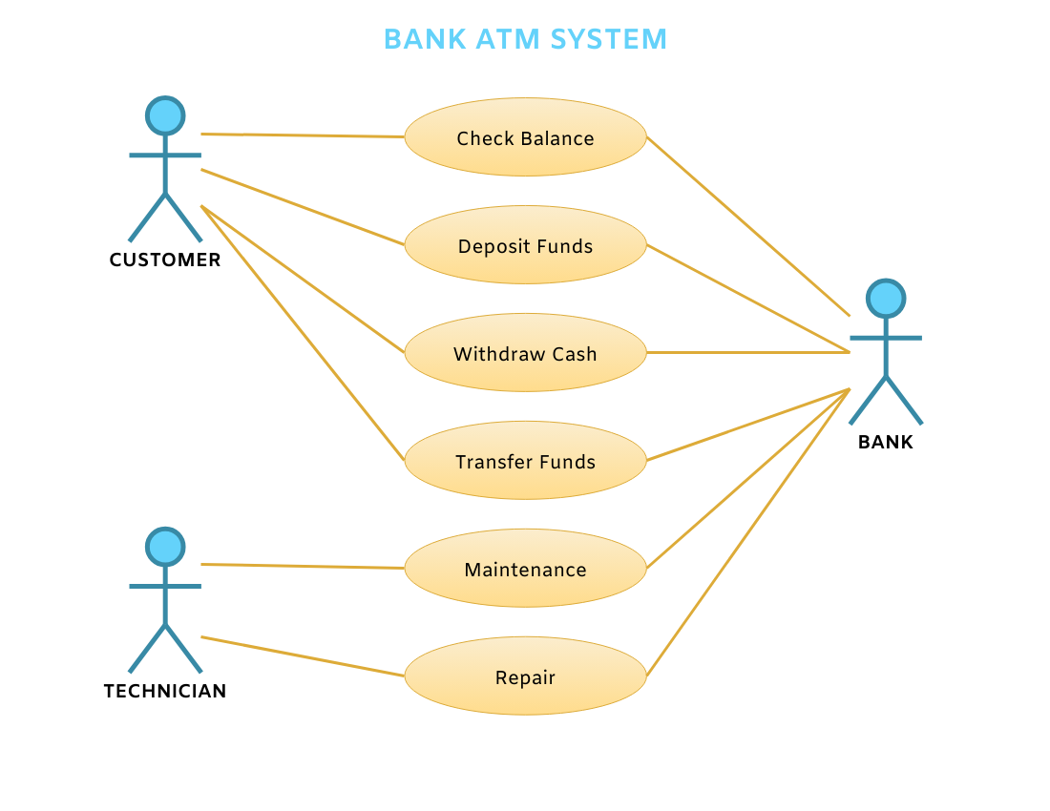

Slide 58
Format and guideline to write use case(s)
Use Case ID: | Enter a unique numeric identifier for the Use Case. e.g. UC-1.2.1
Use Case Name: | Enter a short name for the Use Case using an active verb phrase. e.g. Withdraw Cash
Actors: | [An actor is a person or other entity external to the software system being specified who interacts with the system and performs use cases to accomplish tasks. Different actors often correspond to different user classes, or roles, identified from the customer community that will use the product. Name the actor that will be initiating this use case (primary) and any other actors who will participate in completing the use case (secondary).]
Description: | [Provide a brief description of the reason for and outcome of this use case.]
Trigger: | [Identify the event that initiates the use case. This could be an external business event or system event that causes the use case to begin, or it could be the first step in the normal flow.]

Slide 59
Preconditions: | [List any activities that must take place, or any conditions that must be true, before the use case can be started. Number each pre-condition. e.g. Customer has active deposit account with ATM privileges Customer has an activated ATM card.]
Postconditions: | [Describe the state of the system at the conclusion of the use case execution. Should include both minimal guarantees (what must happen even if the actor’s goal is not achieved) and the success guarantees (what happens when the actor’s goal is achieved. Number each post-condition. e.g. Customer receives cash Customer account balance is reduced by the amount of the withdrawal and transaction fees]

Slide 60
Normal Flow: | [Provide a detailed description of the user actions and system responses that will take place during execution of the use case under normal, expected conditions. This dialog sequence will ultimately lead to accomplishing the goal stated in the use case name and description. Customer inserts ATM card Customer enters PIN System prompts customer to enter language performance English or Spanish System validates if customer is in the bank network System prompts user to select transaction type Customer selects Withdrawal From Checking System prompts user to enter withdrawal amount … System ejects ATM card]

Slide 61
Alternative Flows: [Alternative Flow 1 – Not in Network] | [Document legitimate branches from the main flow to handle special conditions (also known as extensions). For each alternative flow reference the branching step number of the normal flow and the condition which must be true in order for this extension to be executed. e.g. Alternative flows in the Withdraw Cash transaction: 4a. In step 4 of the normal flow, if the customer is not in the bank network System will prompt customer to accept network fee Customer accepts Use Case resumes on step 5 4b. In step 4 of the normal flow, if the customer is not in the bank network System will prompt customer to accept network fee Customer declines Transaction is terminated Use Case resumes on step 9 of normal flow Note: Insert a new row for each distinctive alternative flow. ]

Slide 62
Exceptions: | [Describe any anticipated error conditions that could occur during execution of the use case, and define how the system is to respond to those conditions. e.g. Exceptions to the Withdraw Case transaction 2a. In step 2 of the normal flow, if the customer enters and invalid PIN Transaction is disapproved Message to customer to re-enter PIN Customer enters correct PIN Use Case resumes on step 3 of normal flow]
Includes: | [List any other use cases that are included (“called”) by this use case. Common functionality that appears in multiple use cases can be split out into a separate use case that is included by the ones that need that common functionality. e.g. steps 1-4 in the normal flow would be required for all types of ATM transactions- a Use Case could be written for these steps and “included” in all ATM Use Cases.]

Slide 63
Special/Quality Requirements (other information): | [Identify any additional requirements, such as nonfunctional requirements, for the use case that may need to be addressed during design or implementation. These may include performance requirements or other quality attributes.]
Assumptions: | [List any assumptions that were made in the analysis that led to accepting this use case into the product description and writing the use case description. e.g. For the Withdraw Cash Use Case, an assumption could be: The Bank Customer understands either English or Spanish language.]
Business Rule: | Some business rules constrain which roles can perform all or parts of a use case. Perhaps only users who have certain privilege levels can perform specific alternative flows. That is, the rule might impose preconditions that the system must test before letting the user proceed. Business rules can influence specific steps in the normal flow by defining valid input values or dictating how computations are to be performed.

Slide 64
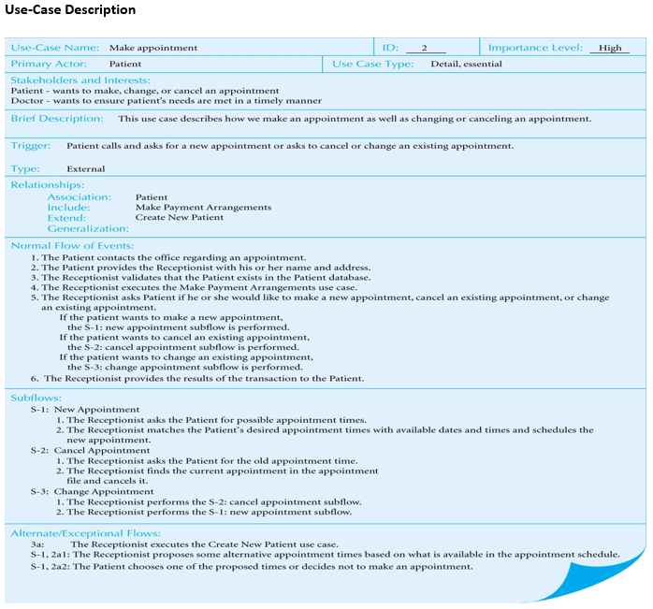
Example Use Case Description

Slide 65
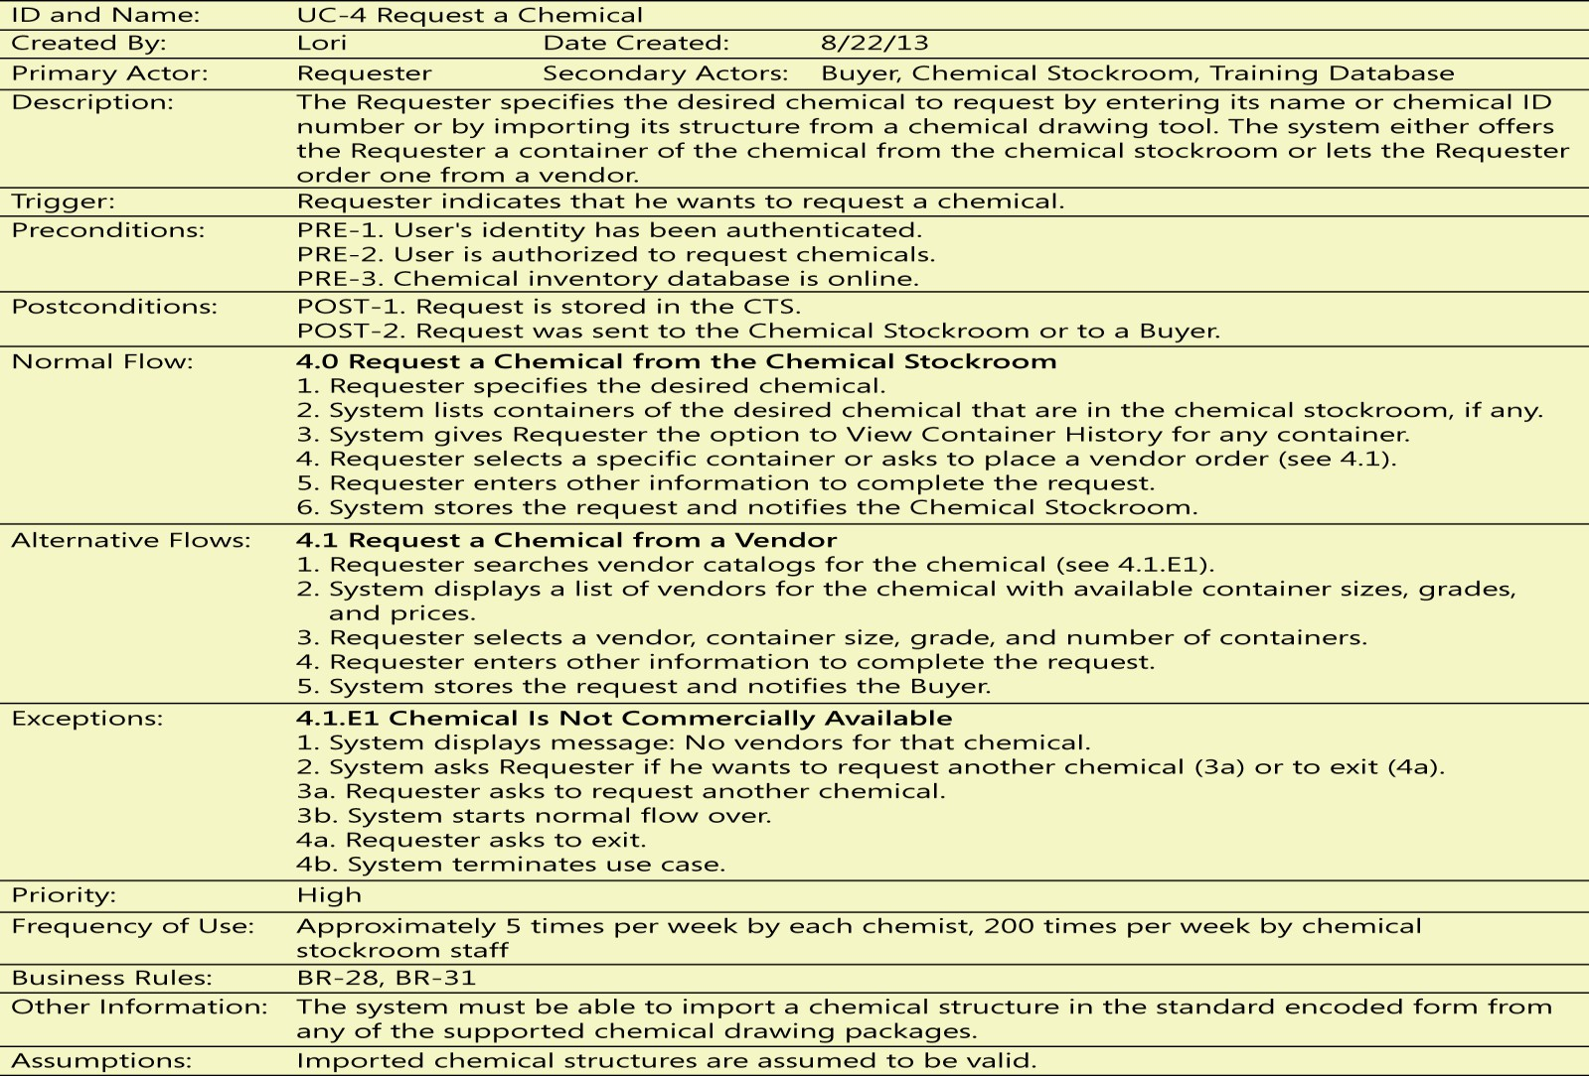
Example Use Case Description

Slide 66
Guidelines for writing requirements
Two important goals of writing requirements are that:
Anyone who reads the requirement comes to the same interpretation as any other reader.
Each reader’s interpretation matches what the author intended to communicate.
These outcomes are more important than purity of style or conforming strictly to some arbitrary rule or convention.

Slide 67
Writing style
Identifier | Requirement ID
Title | Title of requirement
Requirement | Description of requirement e.g If written in system perspective [optional precondition] [optional trigger event] the system shall [expected system response] If written in user perspective The [user class or actor name] shall be able to [do something] [to some object] [qualifying conditions, response time, or quality statement].
Source | Where requirement come from (who demand it)
Rationale | Motivation behind the requirement
Restrictions and Risk | Any restriction and risk that requirement must be fulfilled
Dependencies | Requirements ID that are dependent on this requirement
Priority | High/Medium/Low

Slide 68
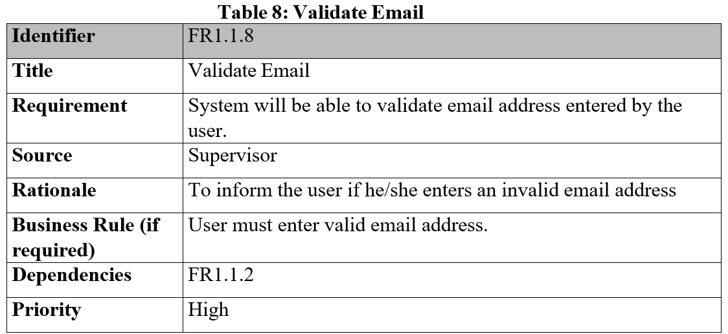
Functional Requirement Example 1

Slide 69
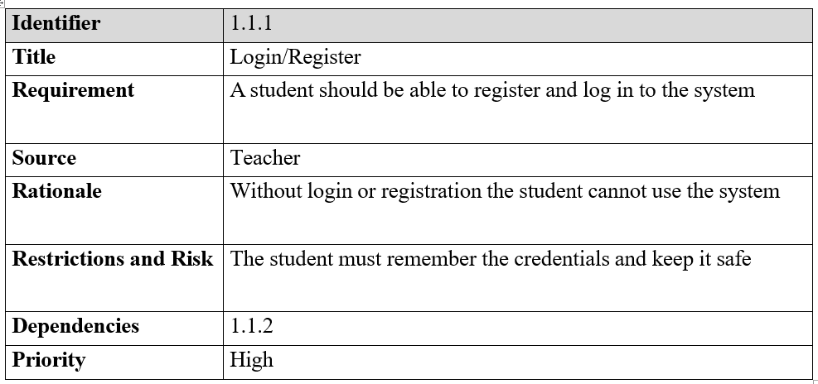
Functional Requirement Example 2

Slide 70
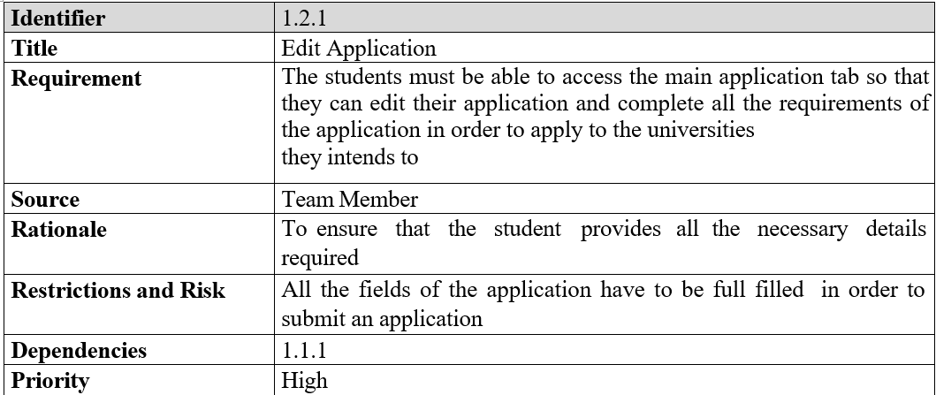
Functional Requirement Example 3

Slide 71
Deriving Functional Requirements from a Use case

Slide 72
Use cases vs functional requirements
Software developers don’t implement business requirements or user requirements.
They implement functional requirements, specific bits of system behavior.
Why we need functional requirements?
Use cases describe the user’s perspective, looking at the externally visible behavior of the system.
They don’t contain all the information that a developer needs to write the software
Example
The user of an ATM doesn’t know about any back-end processing involved, such as communicating with the bank’s computer.
This detail is invisible to the user, yet the developer needs to know about it.

Slide 73
Deriving functional requirements from the use case
Directly derivable
Many functional requirements fall right out of the dialog steps between the actor and the system.
Derive through further analysis
Other functional requirements don’t appear in the use case description.
Example
For instance, the way use cases are typically documented does not specify what the system should do if a precondition is not satisfied.
The BA must derive those missing requirements and communicate them to developers and testers (Wiegers 2006).

Slide 74
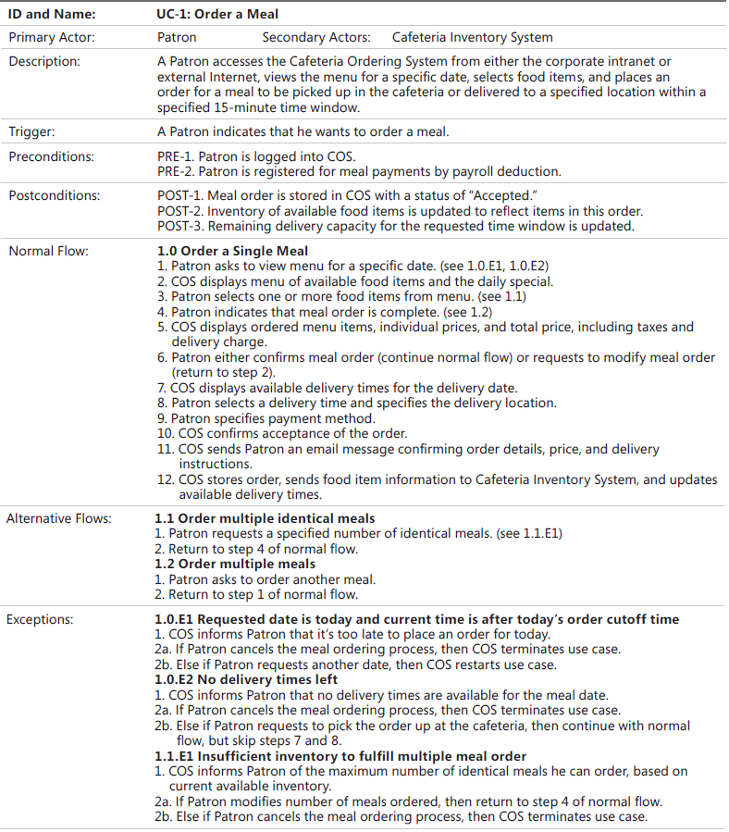
Notes:
Patron= customer here

Slide 75
Order a Meal
Precondition
Possible FR
PRE-1. Patron is logged into COS.
PRE-2. Patron is registered for meal payments by payroll deduction.
Order.Place:
The system shall let a Patron who is logged in to the Cafeteria Ordering System place an order for one or more meals.
Order.Place.Register:
The system shall confirm that the Patron is registered for payroll deduction to place an order.
Order.Place.Register.No:
If the Patron is not registered for payroll deduction, the system shall give the Patron options to register now and continue placing an order, to place an order for pickup in the cafeteria (not for delivery), or to exit from the COS.

Slide 76
Order a Meal
Possible FR
Normal Flow
1.0 Order a Single Meal
1. Patron asks to view menu for a specific date. (see 1.0.E1, 1.0.E2)
1.0.E1 Requested date is today and current time is after today’s order cutoff time
1. COS informs Patron that it’s too late to place an order for today.
2a. If Patron cancels the meal ordering process, then COS terminates use case.
2b. Else if Patron requests another date, then COS restarts use case.
Order.Place.Date:
The system shall prompt the Patron for the meal date (see BR-8).
BR-8: Meals must be ordered within 14 calendar days of the meal date.
Order.Place.Date.Cutoff:
If the meal date is the current date and the current time is after the order cutoff time, the system shall inform the patron that it’s too late to place an order for today. The Patron may either change the meal date or cancel the order.

Slide 77
Order a Meal
Normal Flow
Possible FR
3. Patron selects one or more food items from menu. (see 1.1 of Alternative Flow)
1.1 Order multiple identical meals
Patron requests a specified number of identical meals. (see 1.1.E1)
1.1.E1 Insufficient inventory to fulfill multiple meal order
1. COS informs Patron of the maximum number of identical meals he can order, based on current available inventory.
2a. If Patron modifies number of meals ordered, then return to step 4 of normal flow.
2b. Else if Patron cancels the meal ordering process, then COS terminates use case..
Order.Units.Food:
The system shall allow the Patron to indicate the number of units of each menu item that he wishes to order.
Order.Units.Multiple:
The system shall permit the user to order multiple identical meals, up to the fewest available units of any menu item in the order.
Order.Units.TooMany:
If the Patron orders more units of a menu item than are presently in the cafeteria's inventory, the system shall inform the Patron of the maximum number of units of that food item that he can order.
Order.Units.Change:
If the available inventory cannot fulfill the number of units ordered, the Patron may change the number of units ordered, change the number of identical meals being ordered, or cancel the meal order.

Slide 78
Order a Meal
Normal Flow
Possible FR
5. COS displays ordered menu items, individual prices, and total price, including taxes and delivery charge.
6. Patron either confirms meal order (continue normal flow) or requests to modify meal order (return to step 2 of NF).
7. COS displays available delivery times for the delivery date.
8. Patron selects a delivery time and specifies the delivery location.
Order.Confirm.Display:
When the Patron indicates that he does not wish to order any more food items, the system shall display the food items ordered, the individual food item prices, and the payment amount, calculated per BR-12.
BR-12: Order price is calculated as the sum of each food item price times the quantity of that food item ordered, plus applicable sales tax, plus a delivery charge if a meal is delivered outside the free delivery zone.
Order.Confirm.Prompt:
The system shall prompt the Patron to confirm the meal order.
Order.Confirm.Not:
If the Patron does not confirm the meal order, the Patron may either edit or cancel the order.
Order.Deliver.Select:
The Patron shall specify whether the order is to be picked up or delivered.
Order.Deliver.Location:
If the order is to be delivered and there are still available delivery times for the meal date, the Patron shall provide a valid delivery location.

Slide 79
Order a Meal
Possible FR
Normal Flow
9. Patron specifies payment method.
10. COS confirms acceptance of the order.
Order.Pay.Method:
When the Patron indicates that he is done placing orders, the system shall ask the user to select a payment method.
Order.Pay.Confirm:
The Patron shall either confirm the order, request to edit the order, or request to cancel the order.
Order.Pay.Confirm.Deduct:
If the Patron confirmed the order and selected payment by payroll deduction, the system shall issue a payment request to the Payroll System.

Slide 80
Order a Meal
Possible FR
Normal Flow
11. COS sends Patron an email message confirming order details, price, and delivery instructions.
12. COS stores order, sends food item information to Cafeteria Inventory System, and updates available delivery times.
Order.Done.Patron:
Send an e-mail message to the Patron with the meal order and meal payment information.
Order.Done.Cafeteria:
Send an e-mail message to the Cafeteria Staff with the meal order information.
Order.Done:
When the Patron has confirmed the order, the system shall do the following as a single transaction:
Order.Done.Store:
Assign the next available meal order number to the meal and store the meal order with an initial status of "Accepted."
Order.Done.Inventory:
Send a message to the Cafeteria Inventory System with the number of units of each food item in the order.
Order.Done.Menu:
Update the menu for the current order's order date to reflect any items that are now out of stock in the cafeteria inventory.
Order.Done.Times:
Update the remaining available delivery times for the date of this order.

Slide 81
Quality attributes for Non-Functional Requirements

Slide 82
Quality attributes
Quality attributes are also known as quality factors, quality of service requirements, constraints, and the “–ilities.”
They describe the product’s characteristics in various dimensions that are important either to users or to developers and maintainers, such as performance, safety, availability, and portability.
Other classes of nonfunctional requirements describe external interfaces between the system and the outside world.
These include connections to other software systems, hardware components, and users, as well as communication interfaces.
Design and implementation constraints impose restrictions on the options available to the developer during construction of the product.

Slide 83
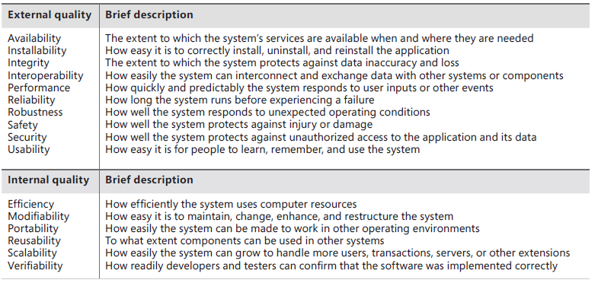
Some Software Quality Attribute

Slide 84
Requirement Validation
Requirements reviews
Systematic manual analysis of the requirements.
Reviewing the documented requirements to correct any problems before the development group accepts them.
Test-case generation
Developing tests for requirements to check testability.
Iterative refinement
Plan for multiple cycles of exploring requirements, progressively refining high-level requirements into more precision and detail, and confirming correctness with users.

Slide 85
Requirements management
Requirements management activities include the following:
Defining the requirements baseline, a snapshot in time that represents an agreed-upon, reviewed, and approved set of functional and nonfunctional requirements, often for a specific product release or development iteration
Evaluating the impact of proposed requirements changes and incorporating approved changes into the project in a controlled way
Negotiating new commitments based on the estimated impact of requirements changes
Defining the relationships and dependencies that exist between requirements
Tracing individual requirements to their corresponding designs, source code, and tests.
Tracking requirements status and change activity throughout the project

Slide 86
Thank you!

